Slide 1
Prompting for Task Automation
Submitted By
Bhargavi Thentu
Organization
SkillCraft Technology

Slide 2
Introduction to Task Automation
Task automation using prompt engineering involves designing structured prompts that help AI systems automate repetitive and real-world tasks such as summarizing notes, extracting data, generating emails, and converting formats.
Key Points
Saves time
Improves productivity
Generates structured outputs

Slide 3
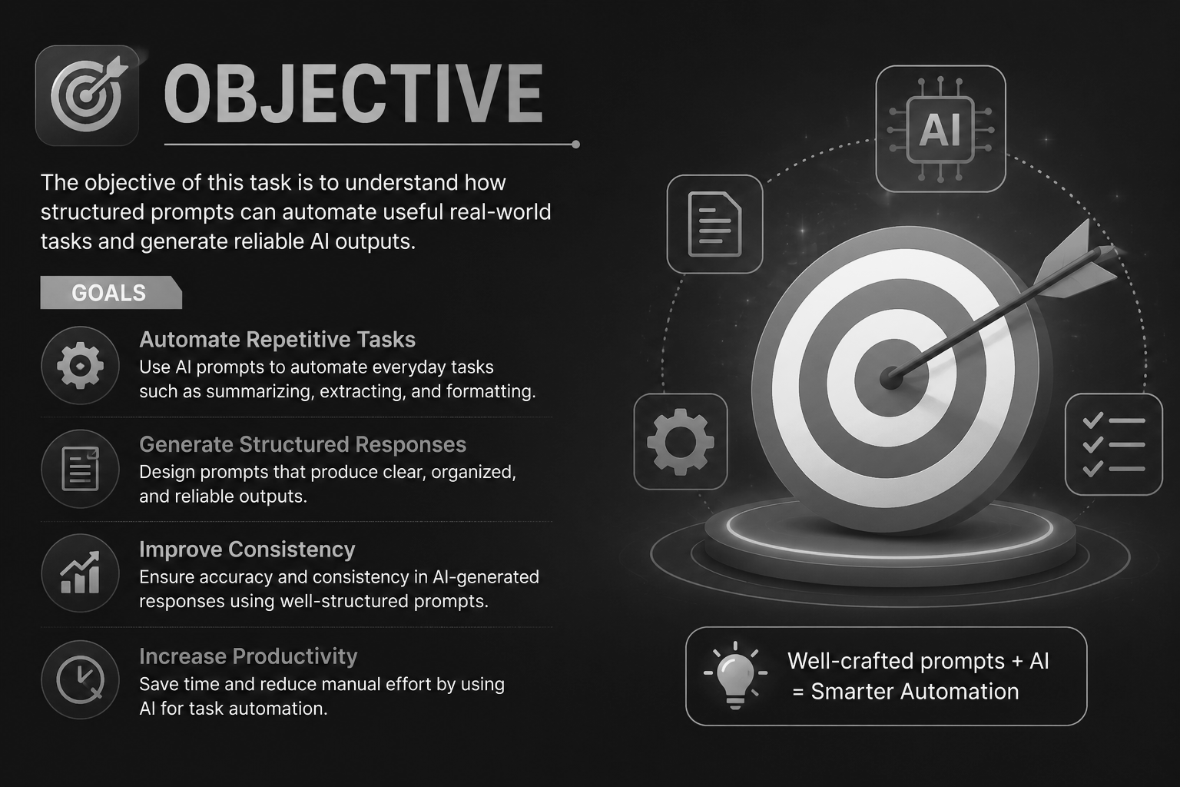
Objective
The objective of this task is to understand how structured prompts can automate useful real-world tasks and generate reliable AI outputs.
Goals
Automate repetitive tasks
Generate structured responses
Improve consistency using prompts

Slide 4
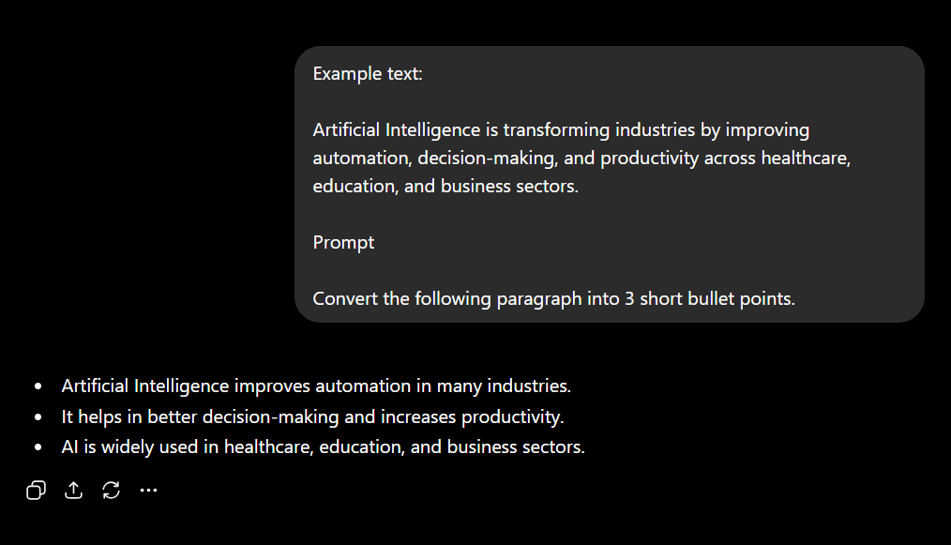
Example 1 — Notes Summarizer
Observation
AI summarized content accurately
Structured prompts improved readability
Automation saved time

Slide 5
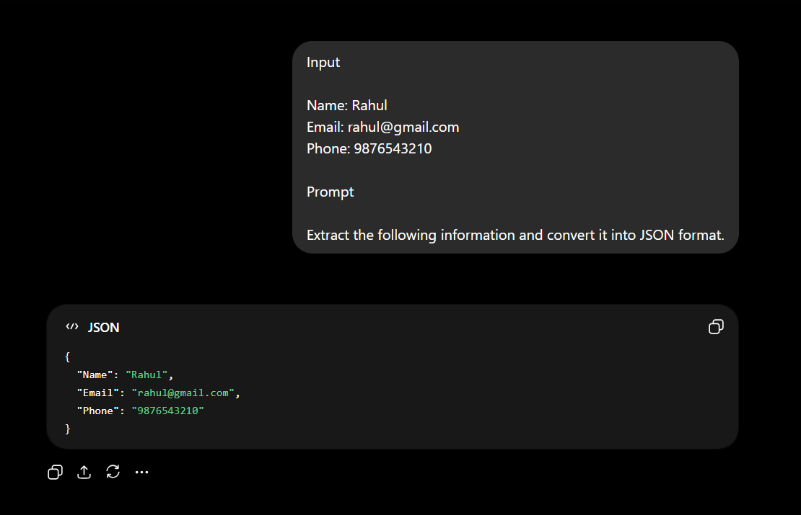
Example 2 — Data Extraction
Observation
AI generated structured data
Prompt improved consistency
Useful for automation workflows

Slide 6
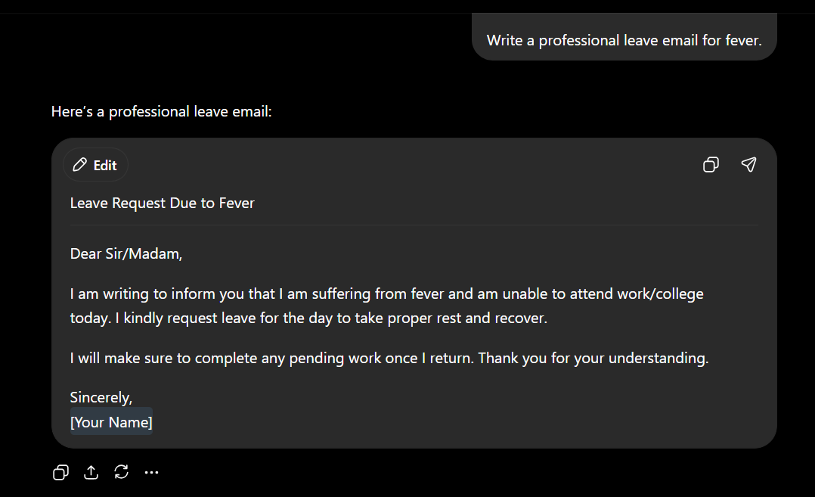
Example 3 — Email Generator
Observation
AI generated formal communication
Prompt automated writing task
Output was professional and concise

Slide 7
Key Learnings
Points
Structured prompts automate repetitive tasks
AI can generate organized outputs
Prompt engineering improves productivity
Automation reduces manual effort
AI assists in professional communication

Slide 8
Conclusion
Prompt engineering can effectively automate real-world tasks by generating accurate, structured, and reliable outputs. This task demonstrated how AI can improve efficiency and productivity through automation.

Slide 9
Thank you

